Slide 1
CAMR: Coded Aggregated MapReduce
Konstantinos Konstantinidis and Aditya Ramamoorthy
The 2019 IEEE International Symposium on Information Theory (ISIT)

Slide 2
INTRODUCTION
PROBLEM FORMULATION
DESCRIPTION OF THE COMPRESSED CDC SCHEME
COMMUNICATION LOAD ANALYSIS
COMPARISON WITH OTHER SCHEMES

Slide 3
1. INTRODUCTION
In this paper, we focus on distributed algorithms for which the intermediate values of a particular job computed during the Map phase can be combined locally by the servers before the transmission.
This kind of computation is predominant in machine learning (e.g., ImageNet classification [5] and stochastic gradient descent [11]). Another use case would be the matrix-vector multiplications performed during the forward and backward propagation in neural networks (cf. [12]).
Compression techniques: combining intermediate results of the same computation task.When the Reduce function is commutative and associative, a “combiner function” is proposed to pre-combine multiple intermediate values（传送中间值的和而不是单个中间值）

Slide 4
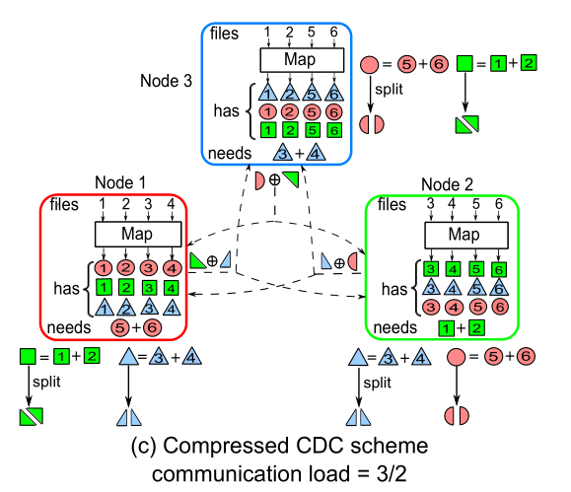
1. INTRODUCTION
Compressed Coded Distributed Computing
Songze Li ∗ , Mohammad Ali Maddah-Ali† , and A. Salman Avestimehr ∗
The 2018 IEEE International Symposium on Information Theory (ISIT)

Slide 5
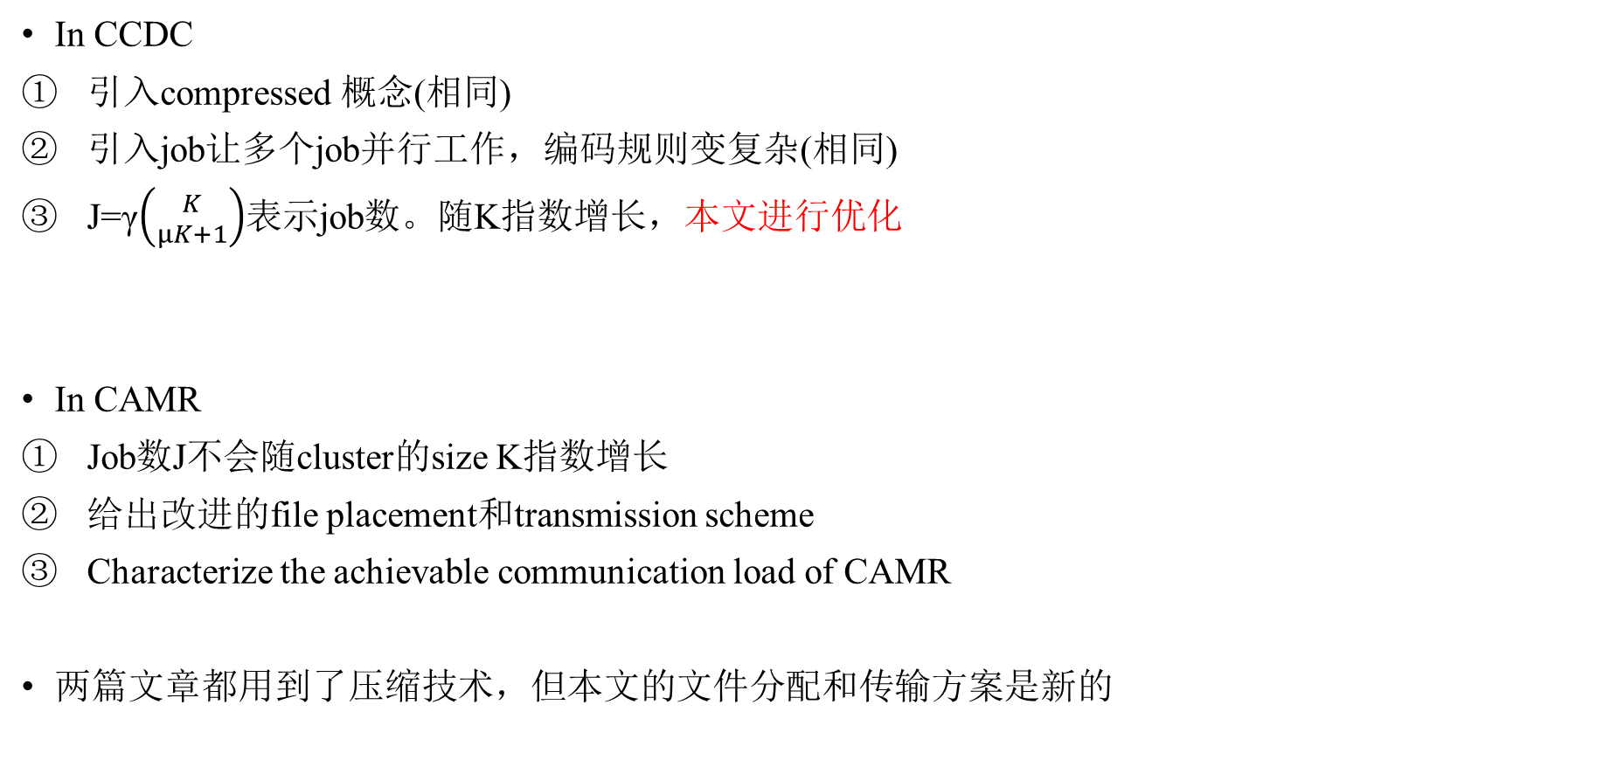
1. INTRODUCTION(Main contributions of our work)
In CCDC
引入compressed 概念(相同)
引入job让多个job并行工作，编码规则变复杂(相同)
J=γ$\left({K \atop μK+1}\right)$表示job数。随K指数增长，本文进行优化
In CAMR
Job数J不会随cluster的size K指数增长
给出改进的file placement和transmission scheme
Characterize the achievable communication load of CAMR
两篇文章都用到了压缩技术，但本文的文件分配和传输方案是新的

Slide 6
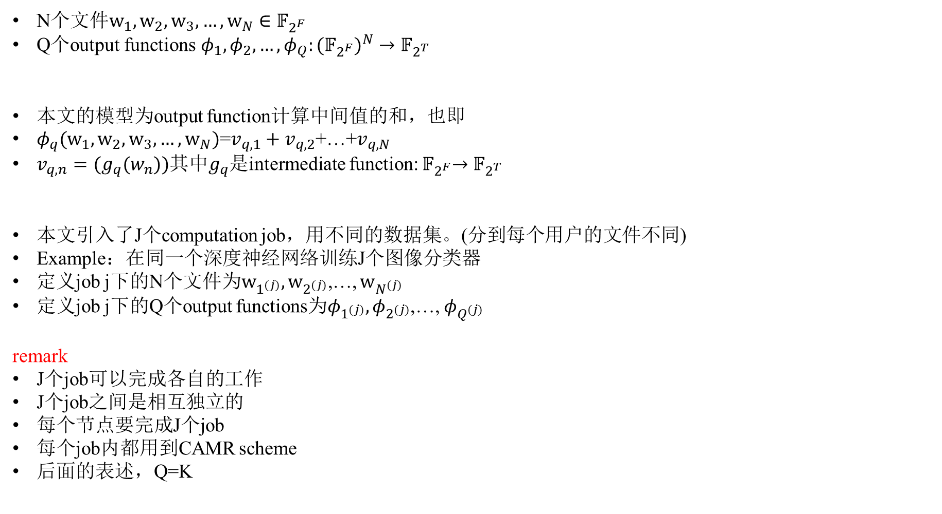
2. PROBLEM FORMULATION
N个$文件w_{1},w_{2},w_{3},…,w_{N}∈𝔽_{2^{F}}$
Q个output functions${ φ}_{1},φ_{2},…,φ_{Q}:{{(𝔽}_{2^{F}})}^{N}→𝔽_{2^{T}}$
本文的模型为output function计算中间值的和，也即
$φ_{q}(w_{1},w_{2},w_{3},…,w_{N})$=$v_{q,1}+v_{q,2}$+…+$v_{q,N}$
$v_{q,n}=(g_{q}(w_{n}))$其中$g_{q}$是intermediate function:${ 𝔽}_{2^{F}}→𝔽_{2^{T}}$
本文引入了J个computation job，用不同的数据集。(分到每个用户的文件不同)
Example：在同一个深度神经网络训练J个图像分类器
定义job j下的N个文件为$w_{1^{(j)}},w_{2^{(j)}}$,…, $w_{N^{(j)}}$
定义job j下的Q个output functions为$φ_{1^{(j)}},φ_{2^{(j)}}$,…, $φ_{Q^{(j)}}$
remark
J个job可以完成各自的工作
J个job之间是相互独立的
每个节点要完成J个job
每个job内都用到CAMR scheme
后面的表述，Q=K

Slide 7
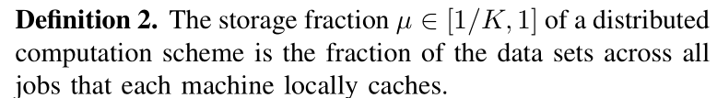
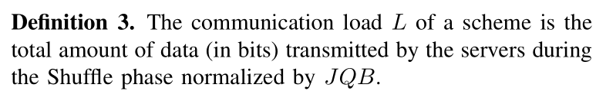

2. PROBLEM FORMULATION
Map phase:对于每个job j,每个节点产生Q个中间值，其大小为B bits
Shuffle phase：对于每个job j,每个节点shuffle中间值。令每个节点传输的数据为$X_{k}∈𝔽_{2^{l_{k}}}$
Reduce phase: 对于每个job j，每个节点计算所有的output$functions φ_{q^{(j)}}$
B是中间值的长度

Slide 8
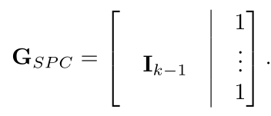

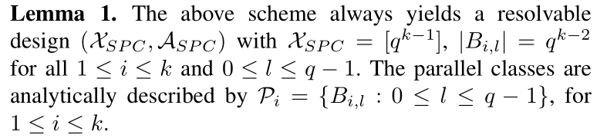

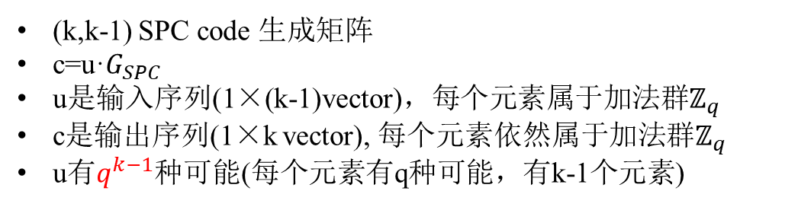
3. DESCRIPTION OF THE CAMR SCHEME(Job assignment)
$X^{\left(j\right)}表示$第j个job被分配给的用户索引（$X^{\left(1\right)}=${$U_{1},U_{3},U_{5}$}）
$B_{i,l}=\left\{j:T_{i,j}=l\right\}$简单来说是每个用户存的job索引
令K=k×q
定义job数J=$q^{k−1}$ (J=γ$\left({K \atop μK+1}\right)$ in CCDC)
J个job怎么分给K个用户？用到奇偶校验矩阵编码
把所有的$q^{k−1}$个输出序列c变成矩阵 这是k×$q^{k−1}的$矩阵
定义$B_{i,l}=\left\{j:T_{i,j}=l\right\}$其中1 ≤ i ≤ k， 0 ≤ l ≤ q−1 这样的$B_{i,l}有$kq个，且$\left|B_{i,j}\right|$=$q^{k−2}$
kq个$B_{i,l}$组成job的分配方案集合$𝒜_{SPC}$，令所有的job索引集合为$𝒳_{SPC}$={1,2,…, $q^{k−1}\}$=[$q^{k−1}$]
(k,k-1) SPC code 生成矩阵
c=u·$G_{SPC}$
u是输入序列(1×(k-1)vector)，每个元素属于加法群$ℤ_{q}$
c是输出序列(1×k vector), 每个元素依然属于加法群$ℤ_{q}$
u有$q^{k−1}$种可能(每个元素有q种可能，有k-1个元素)

Slide 9
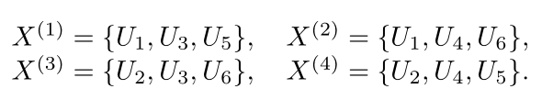
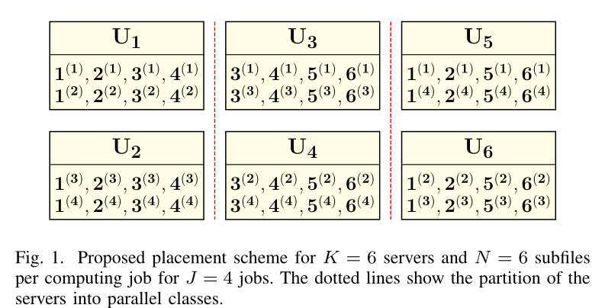
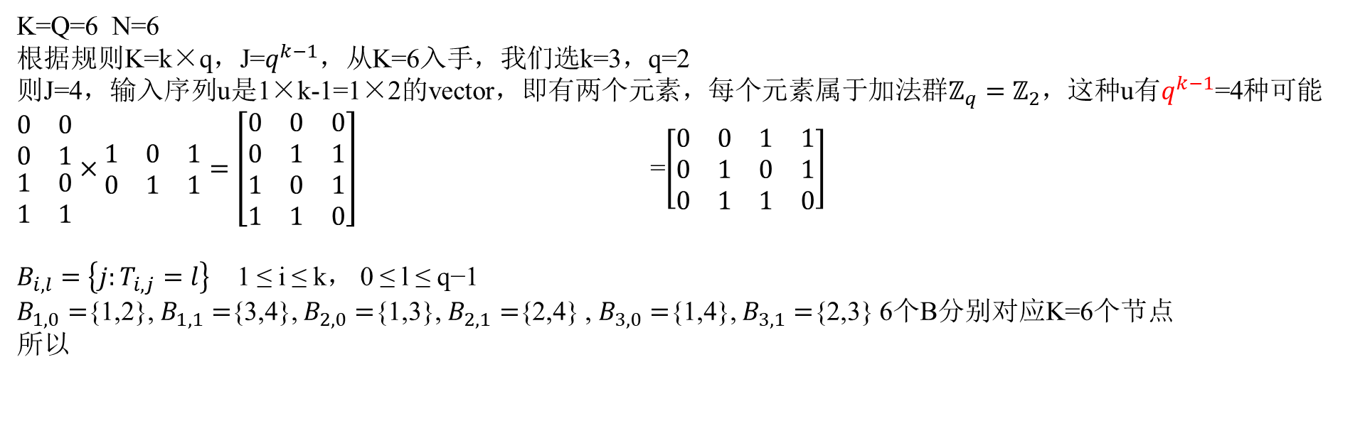

3. DESCRIPTION OF THE CAMR SCHEME(Job assignment Example)
K=Q=6 N=6
根据规则K=k×q，J=$q^{k−1}$，从K=6入手，我们选k=3，q=2
则J=4，输入序列u是1×k-1=1×2的vector，即有两个元素，每个元素属于加法群$ℤ_{q}=ℤ_{2}$，这种u有$q^{k−1}$=4种可能
$\begin{matrix}0 & 0 \\ 0 & 1 \\ \begin{aligned}1 \\ 1\end{aligned} & \begin{aligned}0 \\ 1\end{aligned}\end{matrix}×\begin{matrix}1 & 0 & 1 \\ 0 & 1 & 1\end{matrix}=\left[\begin{matrix}0 & 0 & 0 \\ 0 & 1 & 1 \\ 1 & 0 & 1 \\ 1 & 1 & 0\end{matrix}\right]$ =$\left[\begin{matrix}0 & 0 & 1 & 1 \\ 0 & 1 & 0 & 1 \\ 0 & 1 & 1 & 0\end{matrix}\right]$
$B_{i,l}=\left\{j:T_{i,j}=l\right\}$ 1 ≤ i ≤ k， 0 ≤ l ≤ q−1
$B_{1,0}=${1,2}, $B_{1,1}=${3,4}, $B_{2,0}=${1,3}, $B_{2,1}=${2,4} , $B_{3,0}=${1,4}, $B_{3,1}=${2,3} 6个B分别对应K=6个节点
所以
k
$$q^{k−2}$$
q

Slide 10
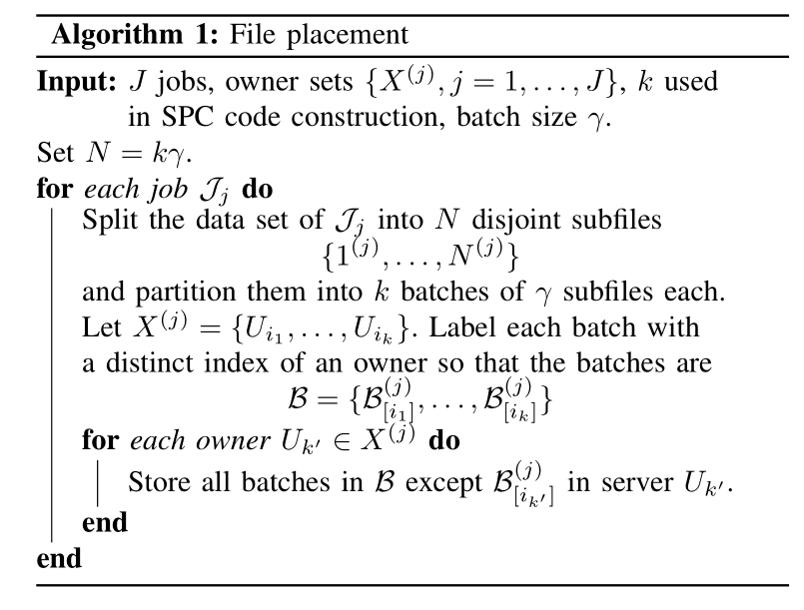
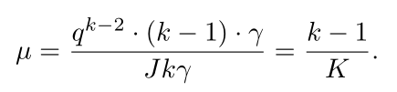
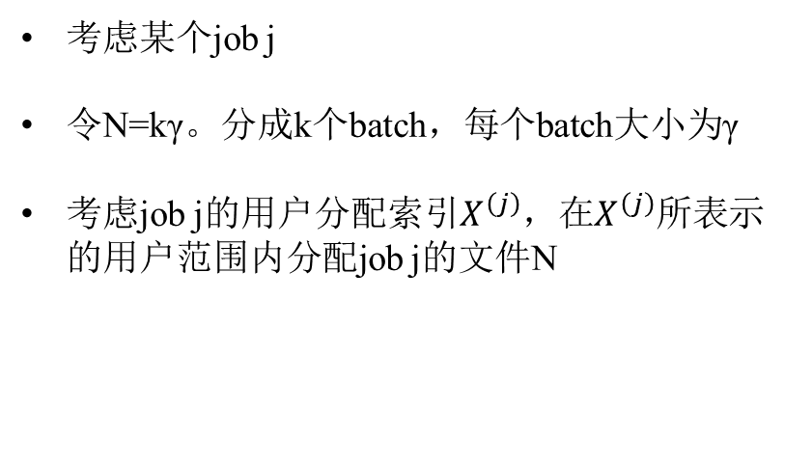
3. DESCRIPTION OF THE CAMR SCHEME(File placement)
考虑某个job j
令N=kγ。分成k个batch，每个batch大小为γ
考虑job j的用户分配索引$X^{\left(j\right)}$，在$X^{\left(j\right)}$所表示的用户范围内分配job j的文件N

Slide 11
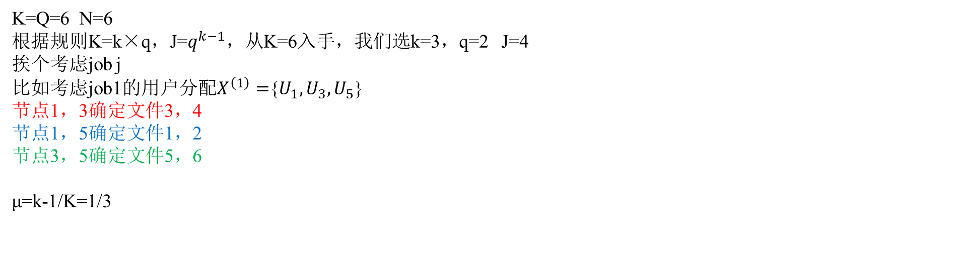
3. DESCRIPTION OF THE CAMR SCHEME(File placement Example)
K=Q=6 N=6
根据规则K=k×q，J=$q^{k−1}$，从K=6入手，我们选k=3，q=2 J=4
挨个考虑job j
比如考虑job1的用户分配$X^{\left(1\right)}=${$U_{1},U_{3},U_{5}$}
节点1，3确定文件3，4
节点1，5确定文件1，2
节点3，5确定文件5，6
μ=k-1/K=1/3

Slide 12
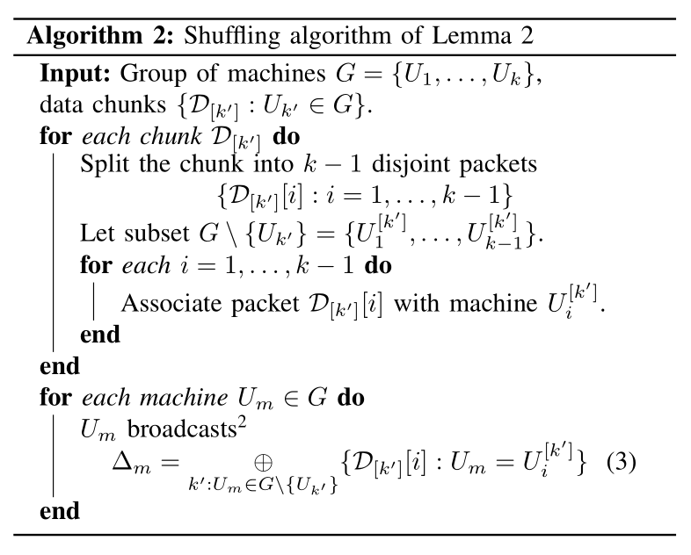
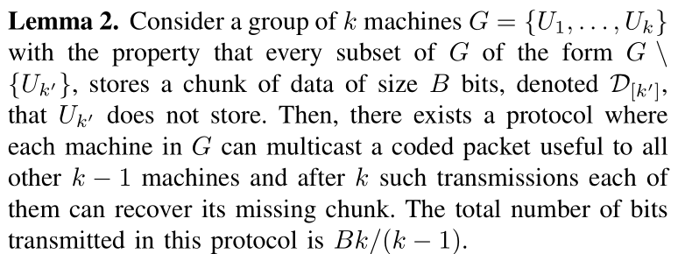
3. DESCRIPTION OF THE CAMR SCHEME(Shuffle phase)
3个stage

Slide 13
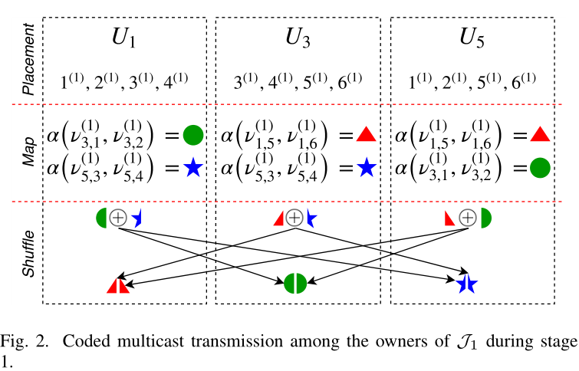

3. DESCRIPTION OF THE CAMR SCHEME(Shuffle phase stage 1)
Stage1：相同job之间的传输
Example
K=Q=6 N=6 k=3 q=2 J=4
考虑$X^{\left(1\right)}=${$U_{1},U_{3},U_{5}$}
考虑U1和U3，
其确定文件3和4
3和4求和
求和后再分给U1和U3
正好是U5需要的
$$L_{stage1}=\frac{6B}{JQB}=\frac{1}{4}$$
Stage1可以完成相同Job的所有中间值传输

Slide 14
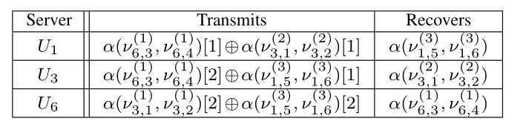



3. DESCRIPTION OF THE CAMR SCHEME(Shuffle phase stage 2)
Stage2：不同job之间的传输
Example
K=Q=6 N=6 k=3 q=2 J=4
考虑其他的用户集合，它是X除去任意一个节点U再加上与之并行的另一个节点
比如考虑G={1，3，6}，任意两个用户确定一个batch
$$L_{stage2}=\frac{6B}{JQB}=\frac{1}{4}$$
考虑$U_{1},U_{3}$
确定$3^{1},4^{1}$
考虑$U_{1},U_{6}$
确定$1^{2},2^{2}$
考虑$U_{3},U_{6}$
确定$5^{3},6^{3}$

Slide 15

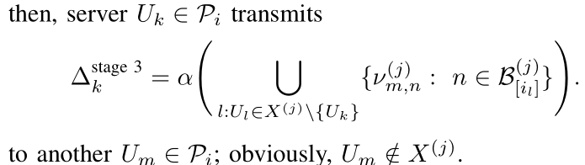

3. DESCRIPTION OF THE CAMR SCHEME(Shuffle phase stage 3)
Stage3：剩下的job
Example
K=Q=6 N=6 k=3 q=2 J=4
比如考虑G={1，3，6}经过stage2的传输后，U1仍然缺少
从并行的U2直接发
$$L_{stage2}=\frac{6×2×B}{JQB}=\frac{1}{2}$$

Slide 16
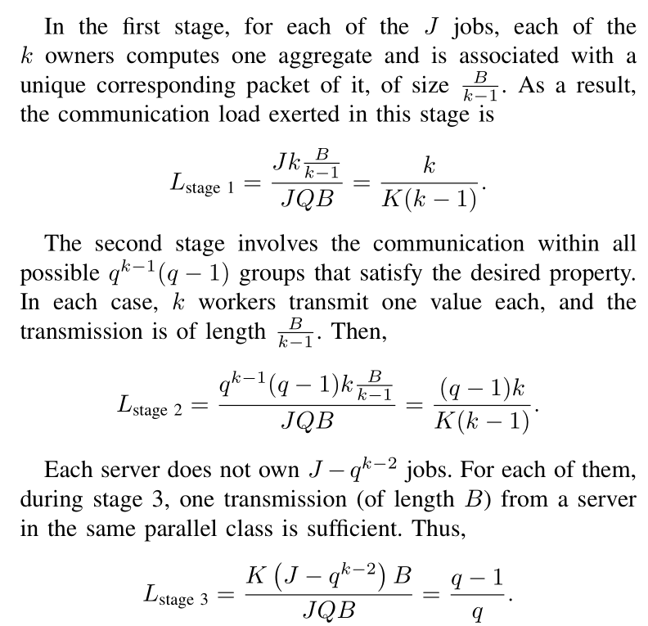
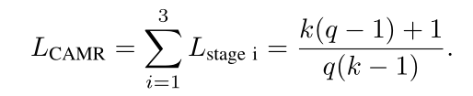
4.COMMUNICATION LOAD ANALYSIS

Slide 17
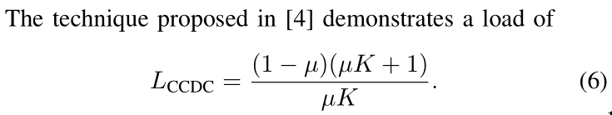
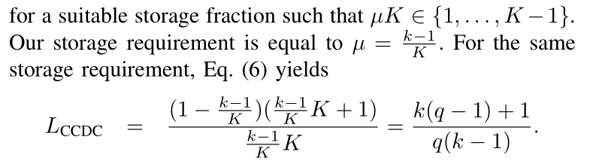
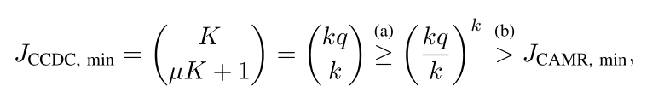

5. COMPARISON WITH OTHER SCHEMES
=
$J_{CDCD,min}=\left({K \atop μK+1}\right)$ $J_{CAMR,min}$=$q^{k−1}$
As q increases the bound of (b) loosens and it turns out that our requirement for the number of jobs becomes exponentially smaller than that of CCDC.

